Slide 1

House Price Prediction
Satish agrawal
DSC 680

Slide 2

Introduction and Problem Statement

Slide 3
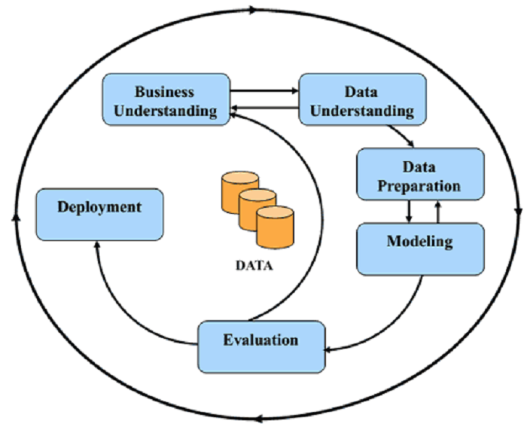
The Process of Machine Learning

Slide 4
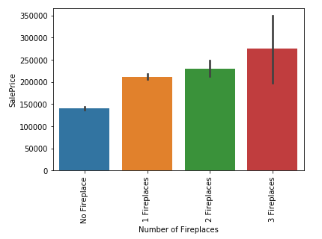
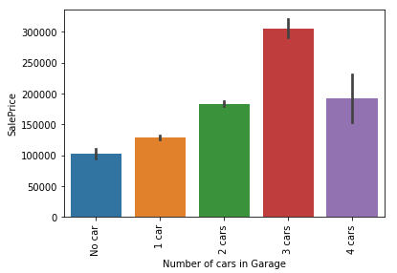
Exploratory Data Analysis

Slide 5
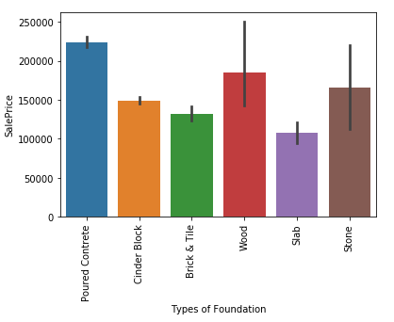
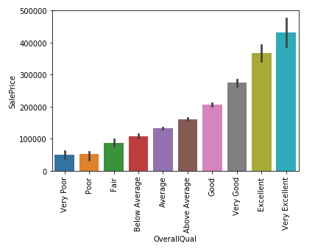
Exploratory Data Analysis

Slide 6
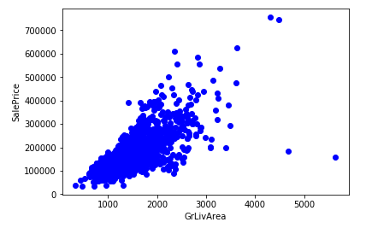
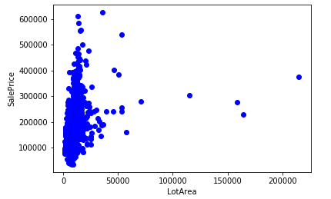
Outliers in the dataset

Slide 7
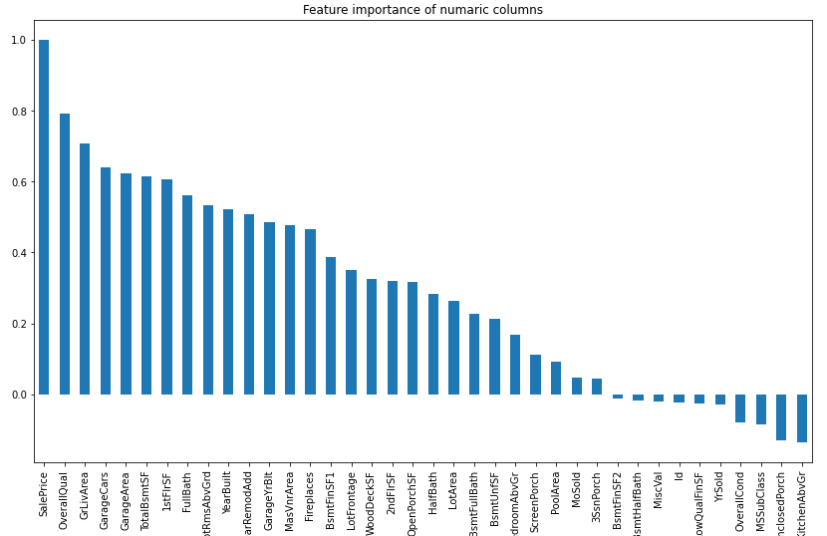
Correlation between Attributes

Slide 8
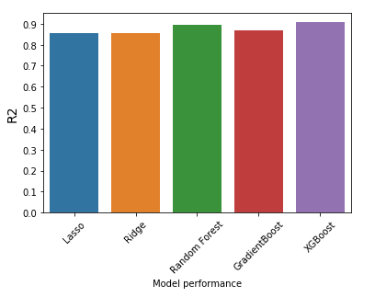
Comparing Models
85.6%
85.6%
89.6%
86.9%
90.7%

Slide 9
Thank You!
Github URL:- https://github.com/satishagrawal/DataScience/tree/main/House%20Price%20Prediction%20-%20Not%20started

